Slide 1
Dimensionality Reduction

Slide 2
Learning Goals
In this section, we will cover:
- Dimensionality reduction overview
- Principal Components Analysis
- Non-negative Matrix Factorization

Slide 3
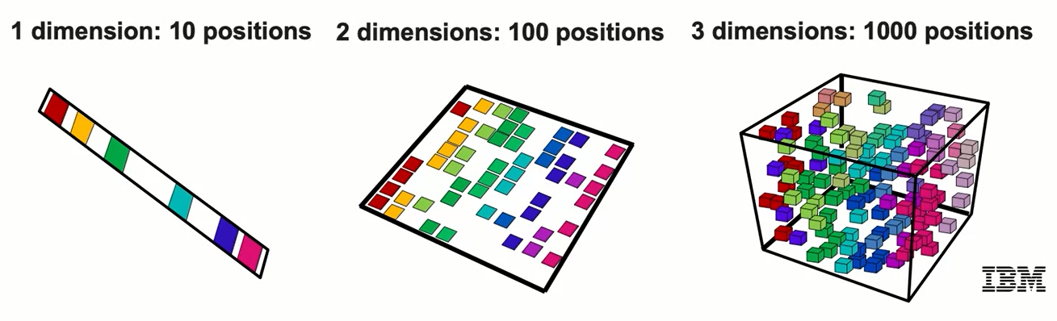
Curse of Dimensionality
Recall that due to the curse of dimensionality:
- In practice, too many features leads to worse performance.
- Distance measures perform poorly and the incidence of outliers increases.

Slide 4
Dimensionality Reduction
This is a very common situation, especially with enterprise datasets that often contain many features.
- Data can be represented by fewer dimensions (features).
- Reduce dimensionality by selecting subset (feature elimination).
- Combine with linear and non-linear transformations.

Slide 5
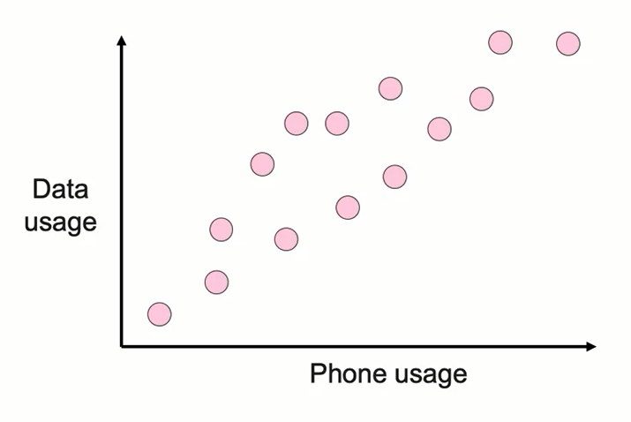
Dimensionality Reduction
- Two features: Phone usage (minutes) and data usage.
- Both features increase together (correlated).
- Can we reduce number of features to one?

Slide 6
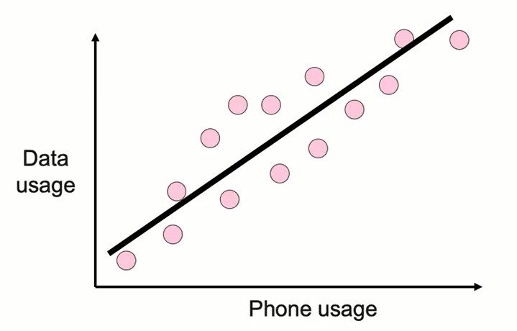
Dimensionality Reduction
- Two features: Phone usage (minutes) and data usage.
- Both features increase together (correlated).
- Can we reduce number of features to one?

Slide 7
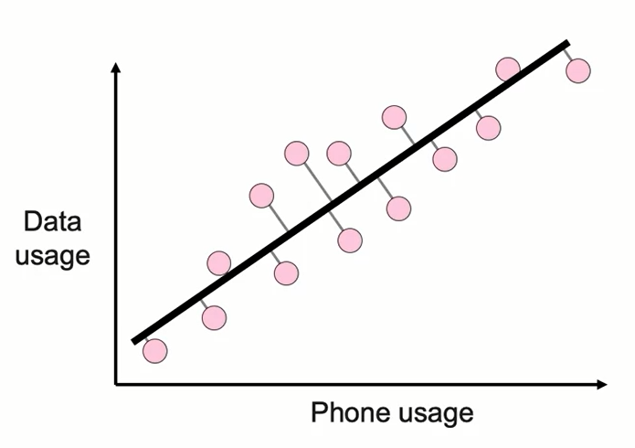
Dimensionality Reduction
- Two features: Phone usage (minutes) and data usage.
- Both features increase together (correlated).
- Can we reduce number of features to one?

Slide 8
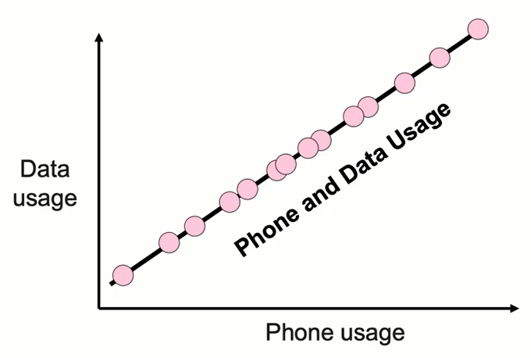
Dimensionality Reduction
- Can we reduce number of features to one?
- Create single feature that is combination of phone and data usage.
- This is Principal Component Analysis (PCA).

Slide 9
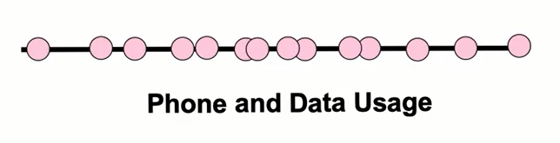
Dimensionality Reduction
- Create single feature that is combination of phone and data usage.
- This is Principal Component Analysis (PCA).

Slide 10
Principal Component Analysis (PCA)
PCA generally tries to find the lower-dimensional surface to project the high-dimensional data.
PCA works by considering the variance of each attribute because the high attribute shows the good split between the classes, and hence it reduces the dimensionality.
Some real-world applications of PCA are image processing, movie recommendation system, optimizing the power allocation in various communication channels.
It is a feature extraction technique, so it contains the important variables and drops the least important variable.

Slide 11
Principal Component Analysis (PCA)
Principal Component Analysis is an unsupervised learning algorithm that is used for the dimensionality reduction in machine learning.
It is a statistical process that converts the observations of correlated features into a set of linearly uncorrelated features with the help of orthogonal transformation. These new transformed features are called the Principal Components.
It is one of the popular tools that is used for exploratory data analysis and predictive modeling.
It is a technique to draw strong patterns from the given dataset by reducing the variances.

Slide 12
Principal Component Analysis (PCA)
The PCA algorithm is based on some mathematical concepts such as:
Variance and Covariance
Eigenvalues and Eigen factors
Some common terms used in PCA algorithm:
Dimensionality: It is the number of features or variables present in the given dataset. More easily, it is the number of columns present in the dataset.
Correlation: It signifies that how strongly two variables are related to each other. Such as if one changes, the other variable also gets changed. The correlation value ranges from -1 to +1. Here, -1 occurs if variables are inversely proportional to each other, and +1 indicates that variables are directly proportional to each other.
Orthogonal: It defines that variables are not correlated to each other, and hence the correlation between the pair of variables is zero.
Eigenvectors: If there is a square matrix M, and a non-zero vector v is given. Then v will be eigenvector if Av is the scalar multiple of v.
Covariance Matrix: A matrix containing the covariance between the pair of variables is called the Covariance Matrix.

Slide 13
Principal Component Analysis (PCA)
As described above, the transformed new features or the output of PCA are the Principal Components (PCs). The number of these PCs are either equal to or less than the original features present in the dataset. Some properties of these principal components are given below:
The principal component must be the linear combination of the original features.
These components are orthogonal, i.e., the correlation between a pair of variables is zero.
The importance of each component decreases when going to 1 to n, it means the 1 PC has the most importance, and n PC will have the least importance.

Slide 14
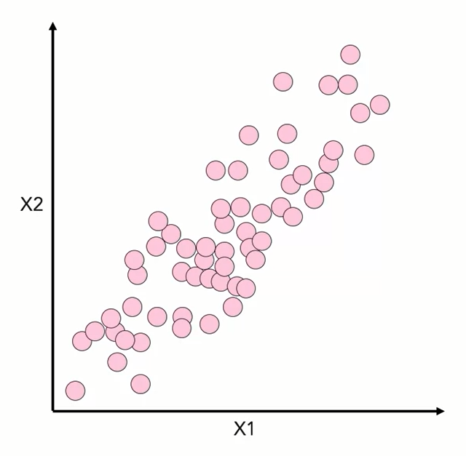
Principal Component Analysis (PCA)

Slide 15
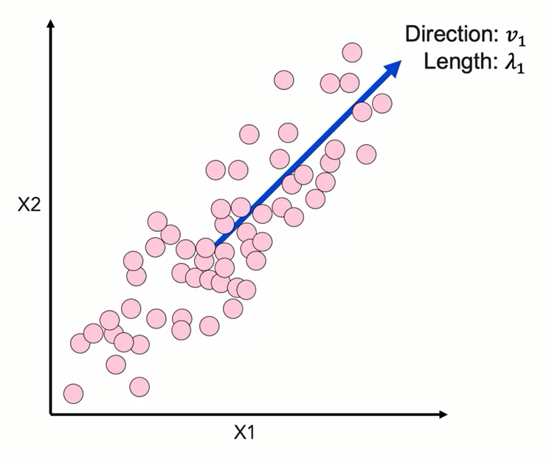
Principal Component Analysis (PCA)

Slide 16
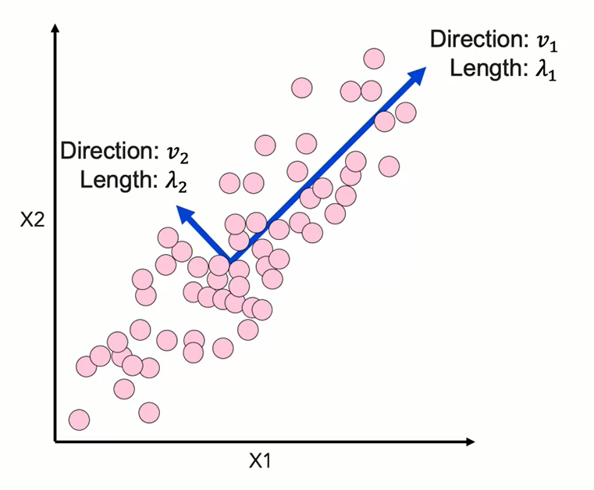
Principal Component Analysis (PCA)

Slide 17
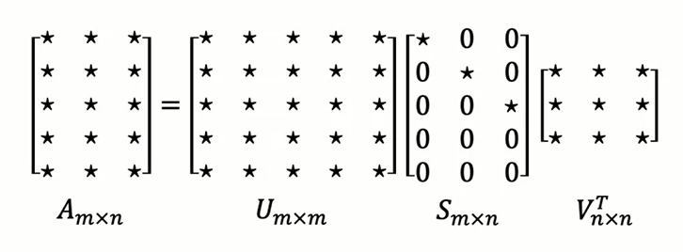
Single Value Decomposition (SVD)
- SVD is a matrix factorization method normally used for PCA.
- Does not require a square data set.

Slide 18
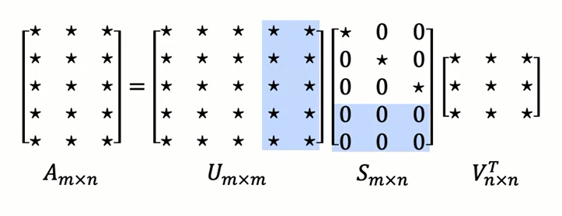
Single Value Decomposition (SVD)
- SVD is a matrix factorization method normally used for PCA.
- Does not require a square data set.
- SVD is used by Scikit-learn for PCA.

Slide 19
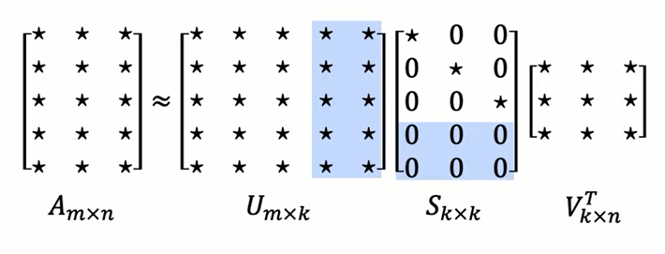
Truncated Single Value Decomposition
- How can SVD be used for dimensionality reduction?
- Principal components are calculated from V.

Slide 20
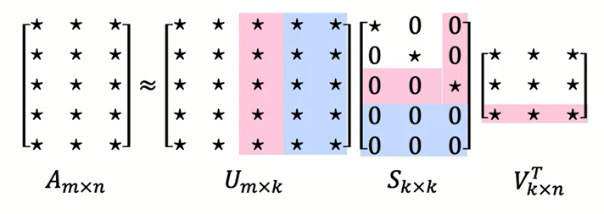
Truncated Single Value Decomposition
- How can SVD be used for dimensionality reduction?
- Principal components are calculated from V.
- "Truncated SVD" used for dimensionality reduction (n → k).

Slide 21
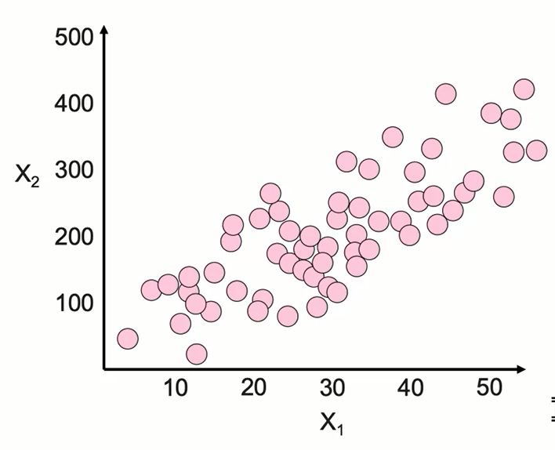
Importance of Feature Scaling
- PCA and SVD seek to find the vectors that capture the most variance.

Slide 22
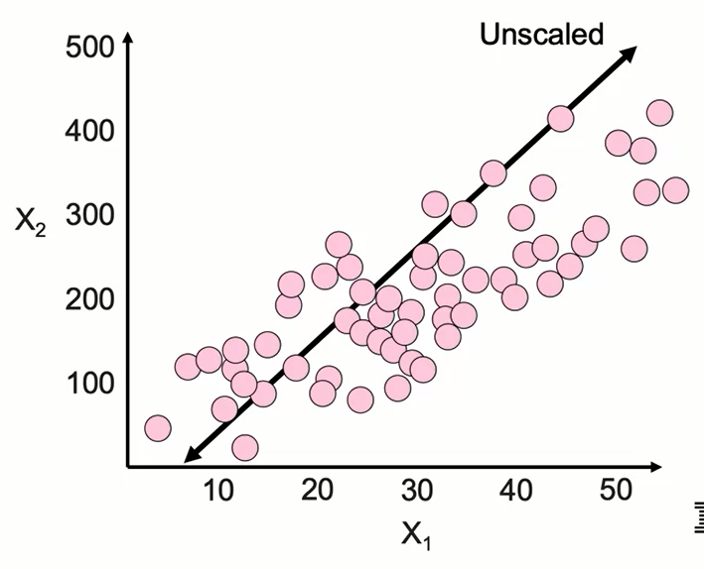
Importance of Feature Scaling
- PCA and SVD seek to find the vectors that capture the most variance.
- Variance is sensitive to axis scale.

Slide 23
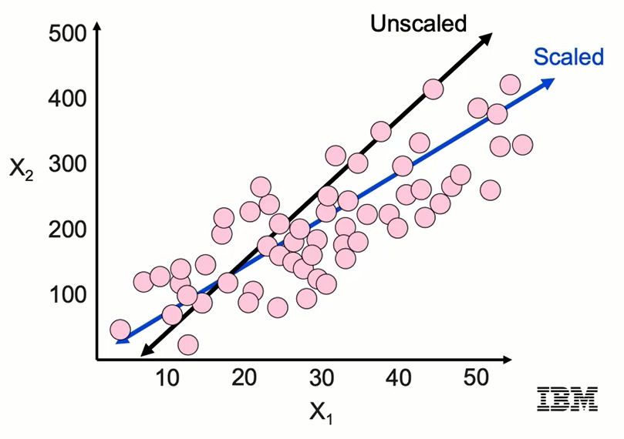
Importance of Feature Scaling
- PCA and SVD seek to find the vectors that capture the most variance.
- Variance is sensitive to axis scale.
- Must scale data!

Slide 24
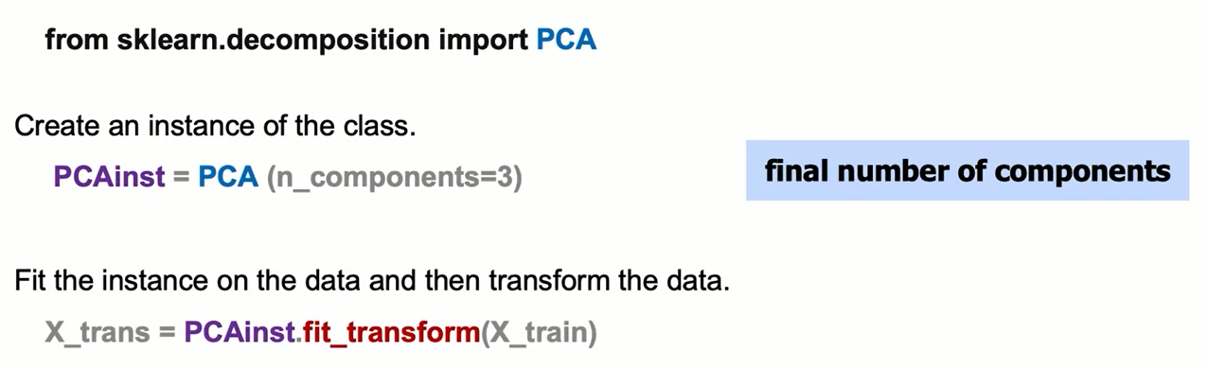
PCA: The Syntax
For example, we can transform the customer churn dataset, which has around 20 numeric features, to one with only 3 features.

Slide 25
Learning Goals
In this section, we will cover:
- Applications of Dimensionality Reduction
- Dimensionality Reduction examples

Slide 26
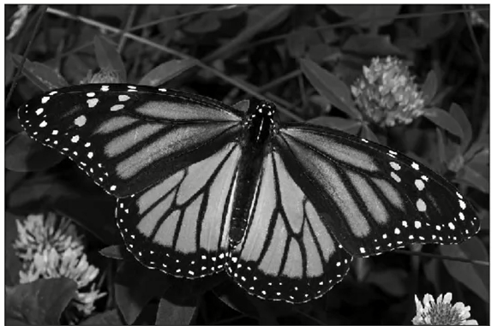
Uses of Dimensionality Reduction
- Frequently used for high dimensionality data.
- Natural language processing (NLP): many word combinations.
- Image-based data sets: pixels are features.

Slide 27
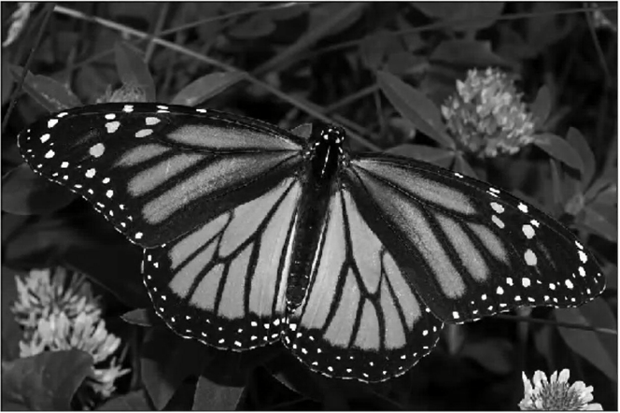
Uses of Dimensionality Reduction
- Divide image into 12 x 12 pixel sections.

Slide 28
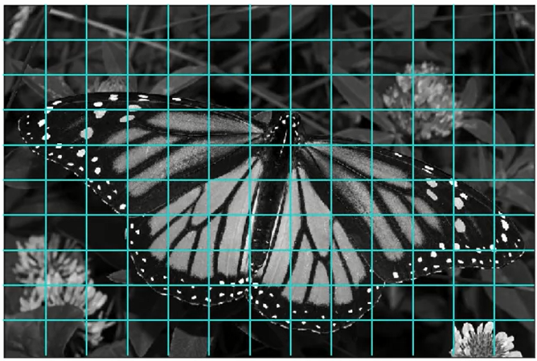
Uses of Dimensionality Reduction
- Divide image into 12 x 12 pixel sections.

Slide 29
Uses of Dimensionality Reduction
- Divide image into 12 x 12 pixel sections.
- Flatten section to create row of data with 144 features.

Slide 30
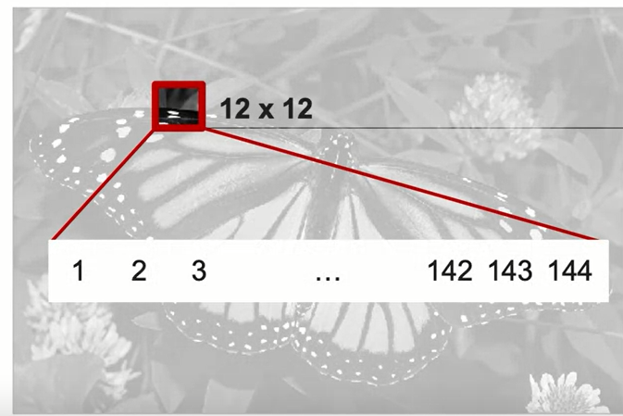
Uses of Dimensionality Reduction
- Divide image into 12 x 12 pixel sections.
- Flatten section to create row of data with 144 features.

Slide 31
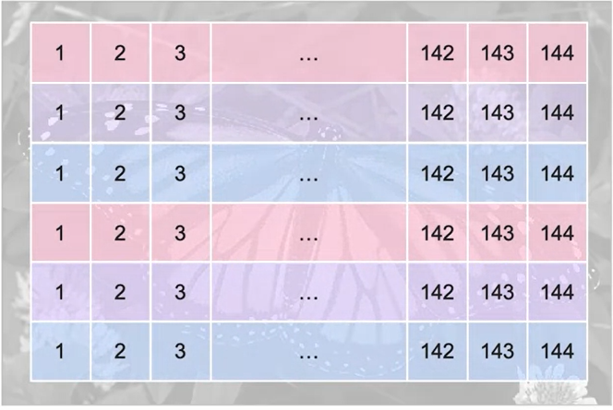
Uses of Dimensionality Reduction
- Perform PCA on all data points.

Slide 32
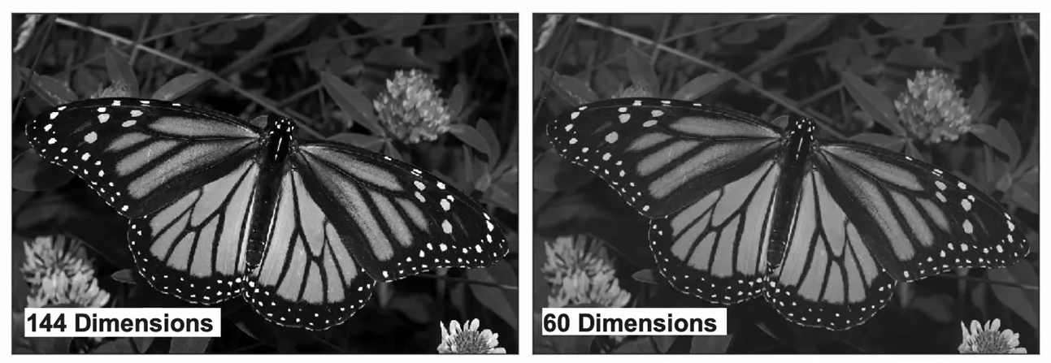
PCA Compression: 144 → 60 Dimensions

Slide 33
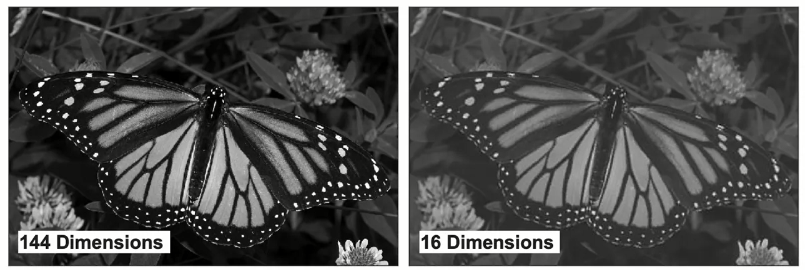
PCA Compression: 144 → 16 Dimensions

Slide 34
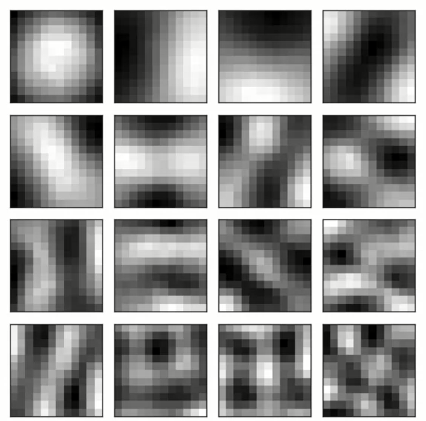
After PCA: Top 16 Components

Slide 35
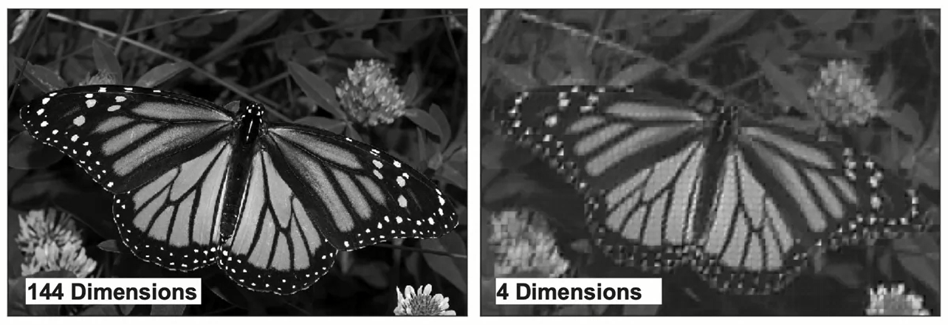
After PCA: Top 16 Components

Slide 36
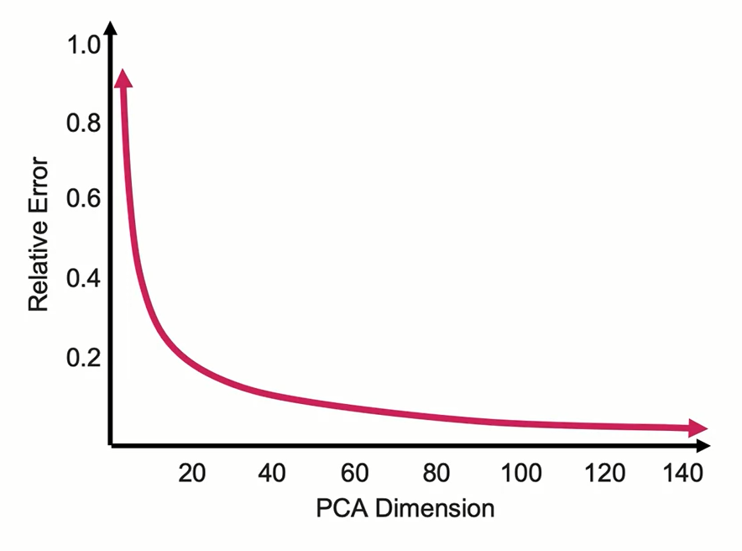
L2 Error vs. Number of PCA Components

Slide 37
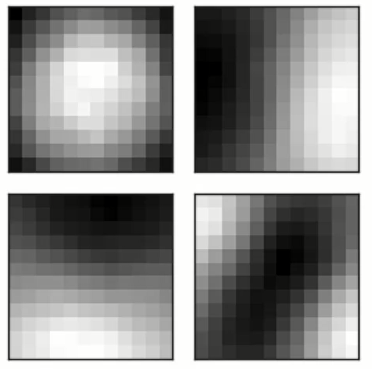
L2 Error vs. Number of PCA Components

Slide 38
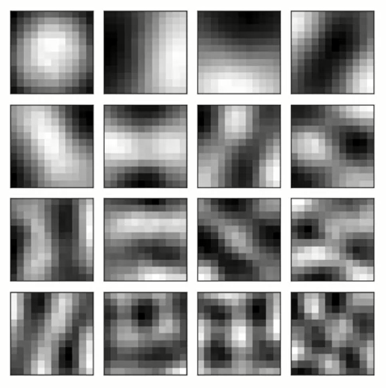
Four Most Important Components

Slide 39
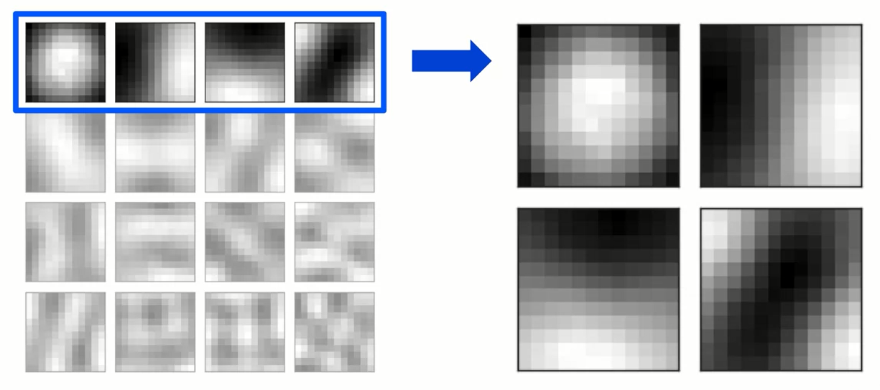
Four Most Important Components

Slide 40
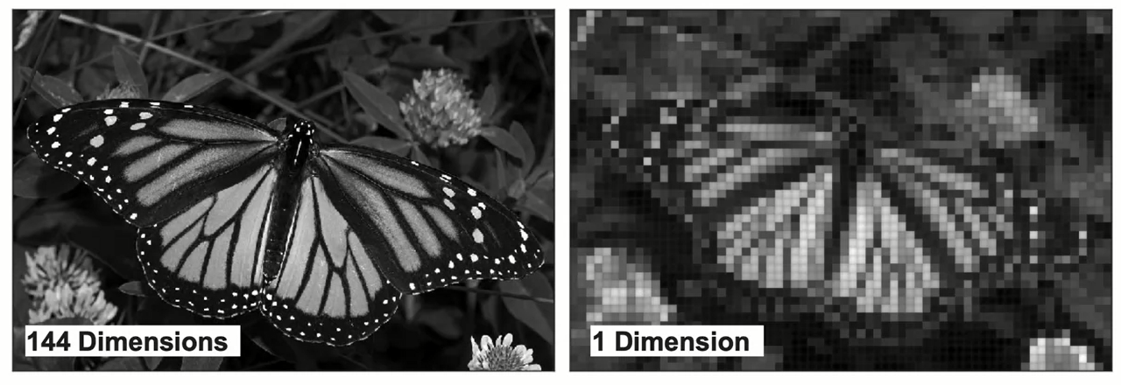
PCA Compression: 144 → 1 Dimension

Slide 41
Learning Recap
In this section, we discussed:
- Applications of Dimensionality Reduction
- Dimensionality Reduction examples

Slide 42
Non-Negative Matrix Factorization

Slide 43
Learning Goals
In this section, we will cover:
- Dimensionality reduction overview
- Principal Components Analysis
- Non-negative Matrix Factorization

Slide 44
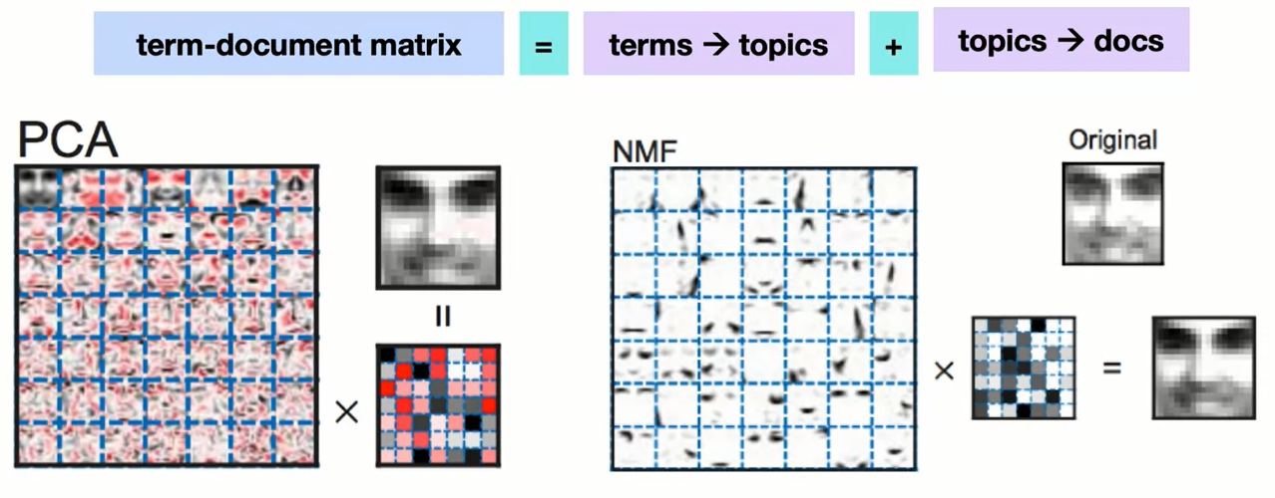
Non-Negative Matrix Factorization
V = W x H: Same idea, but all three matrices must have only positive values.

Slide 45
Why Only Positive Values?
- Since NMF can never undo the application of a latent feature,
it is much more careful about what it adds at each step.
- In some applications, this can make for more human interpretable latent features.
- Because NMF has the extra constraint of positive values,
it will tend to lose more information when truncating.
- Also, NMF does not have to give orthogonal latent vectors.

Slide 46
NMF Summary
Input:
- Count Vectorizer or TF-IDF Vectorizer
Parameters to Tune:
- Number of Topics
- Text Preprocessing (stop words, min / max doc freq, parts of speech...)
Output:
- W Matrix (terms —> topics) and H Matrix (documents —> topics)

Slide 47
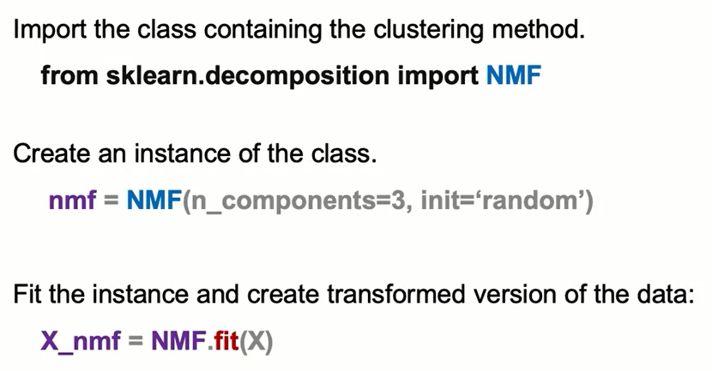
NMF: the Syntax

Slide 48
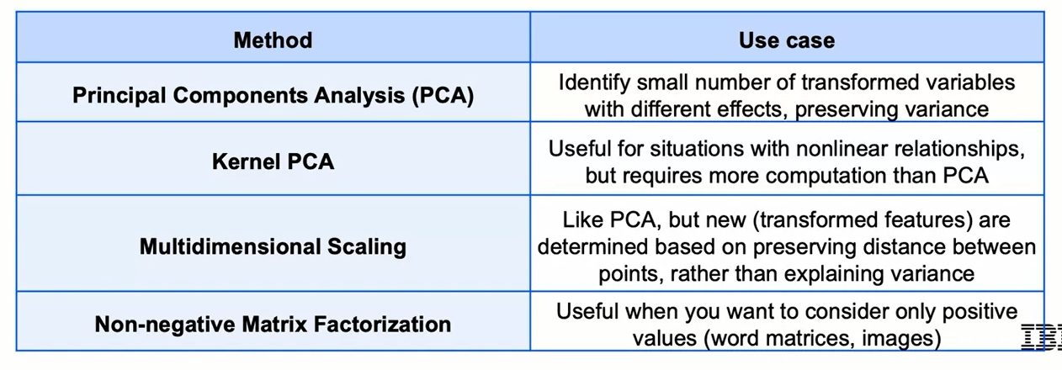
Dimensionality Reduction: Approaches
Dimensionality reduction is common across a wide range of applications
Some rules of thumb for selecting an approach:

Slide 49
Summary
Dimensionality Reduction
As a result of the curse of dimensionality, too many features can lead to worse performance. Often, data can be represented by fewer dimensions (features). There are two ways to reduce dimensionality:
Select a subset of features that are "important"
Combine features using linear/non-linear transformations
Principal Component Analysis
Principal component analysis (PCA) is a dimensionality reduction technique that creates new features by applying linear transformations on a combination of the original features. The resulting features are called principal components, on which the original data will be projected.
Each principal component is a vector and are orthogonal to each other. Their relative importance is determined by comparing how much of the variance within the original data they each explain/preserve.

Slide 50
Summary
Principal Component Analysis
Singular value decomposition (SVD) enables us to find this information by obtaining the diagonal matrix. Its non-zero entries along the diagonal represent each eigenvector(principal component)'s eigenvalue/length. The bigger the value, the more important the vector.
*Note: It is important to scale the data prior to applying PCA because distance is an important aspect considered for the algorithm.
Syntax
The syntax consists of importing the class containing the method:
from sklearn.decomposition import PCA
creating the instance of the class:
pca=PCA(n_components=3)
and fit the instance and create a transformed version of the data:
X_trans=pca.fit_transform(X_train)

Slide 51
Learning Recap
In this section, we discussed:
- Dimensionality reduction overview
- Principal Components Analysis
- Non-negative Matrix Factorization

